Slide 1
Care Coordination
Krista Morris-Lehman, M.A.
204 Norwood Hall
(573) 341-4211
cc@mst.edu
carecoordination.mst.edu

Slide 2
Services Include
Assistance navigating campus and community resources, including referrals for mental/physical health concerns
Coordination and follow-up during and after hospitalization and/or medical leaves of absence
Crisis management
UCARE referrals/Coordination
Assistance managing academic, personal, and fiscal responsibilities
Resource and consultation for faculty, staff, and students
Notes:
The care coordinator supports students throughout their time at S&T.
By identifying immediate needs, providing appropriate resources and working with them to develop a personalized action plan, the care coordinator helps students to face their challenges and succeed.

Slide 3
Student Emergency Fund
Assists students by providing financial support for unexpected emergency expenses.
Funds are provided only when there is funding available.
Funds awarded are generally between $25-$500.
Funding is a one time option and does not need to be repaid.
Students may apply for the fund once they have exhausted other resources.
Approval is based on eligibility, documentation of need and funding availability.
Notes:
The Missouri University of Science and Technology Student Emergency Fund was established by Counseling Services in 2016.
The fund assists S&T students by providing financial support with unexpected emergency expenses.
Students sometimes have unforeseen circumstances that greatly impact their lives.
The fund allows students to meet their needs and continue their education.

Slide 4
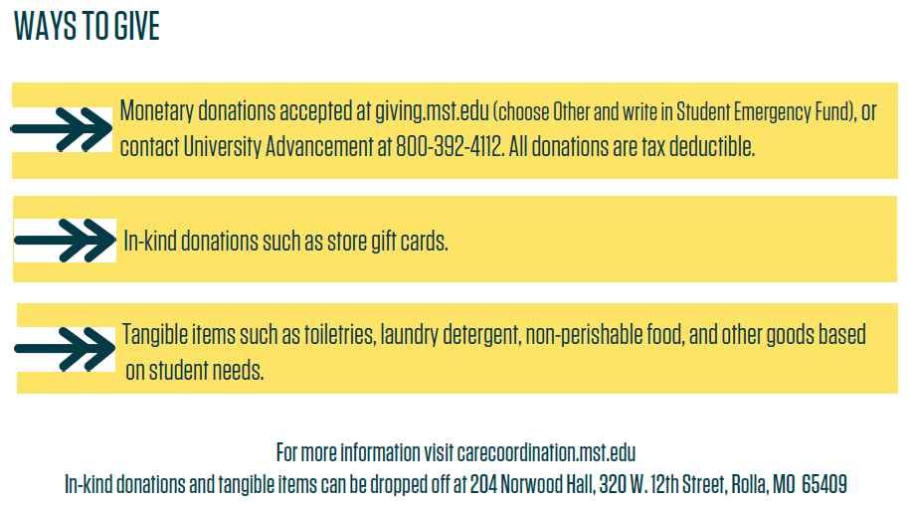
Student Emergency Fund

